Slide 1

Title: User Experience Evaluation of Tasty BYTES App Module: CO2722 - User Experience Student Name: Youssef Elseisi Academic Year: 2024-2025

Slide 2
Purpose of Evaluation: To assess usability using key metrics: Effectiveness, Efficiency, and Satisfaction. Objectives: Identify UX deficiencies, analyze user feedback, and propose data-driven improvements. Method Used: User testing, SUS survey, and task performance tracking.
Introduction
Key evaluation aspects: The usability assessment includes user testing, an SUS survey, and task performance tracking to measure efficiency, effectiveness, and satisfaction (Sauro & Lewis, 2016).

Slide 3
Participants: 5 students with varying levels of experience using food delivery apps. Task Scenarios: Ordering food, checking order history, canceling an item, and navigating the map. Evaluation Metrics: Task completion rate, time taken per task, and SUS scoring.
Evaluation Plan
Participants performed key tasks such as ordering food, checking order history, cancelling an item, and using the map. Their success rates and feedback were recorded (Lazar, Feng, & Hochheiser, 2017).

Slide 4
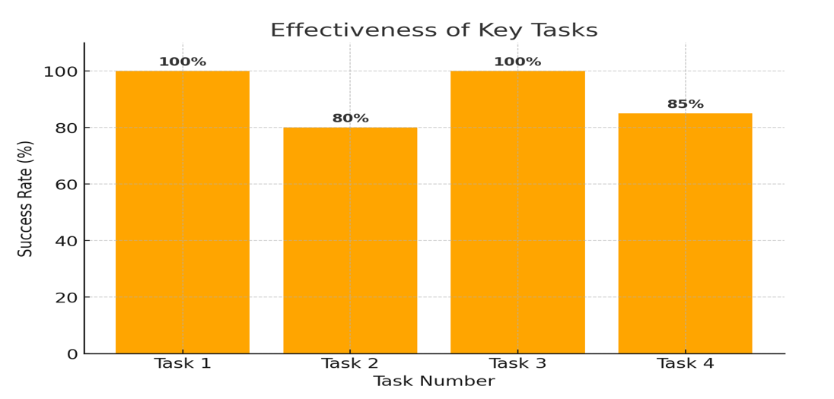
Task Success Rates: Ordering food: 100% Viewing order history: 80% Cancelling an order: 100% Navigating to vendor: 85% Effectiveness Score: 91.25%
Data Analysis – Task Completion & Efficiency
Task success rates indicate high usability, but navigation and discoverability issues were noted, especially regarding the map button (Nielsen, 1994).

Slide 5
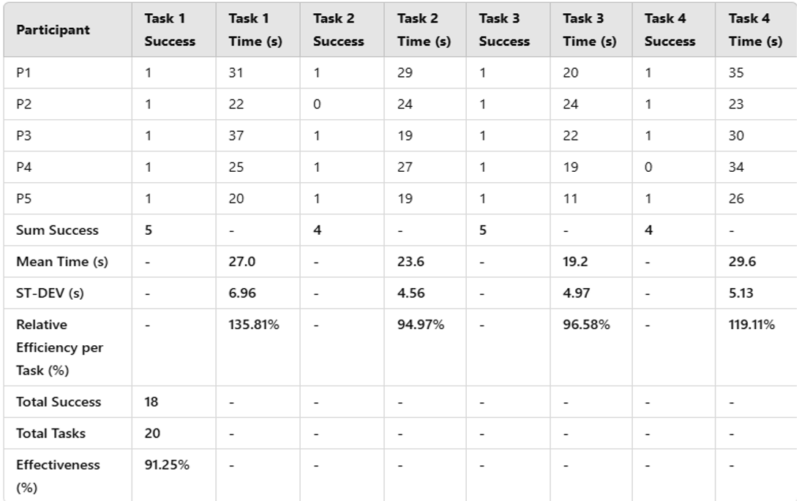
Participant SUS Scores: 62.5 - 90.0 Mean SUS Score: 77.5
System Usability Scale (SUS) Results
Interpretation: Above average usability but with room for improvement.
SUS results show an above-average usability score (77.5), but areas for improvement include clearer feedback and enhanced navigation (Sauro & Lewis, 2016).

Slide 6
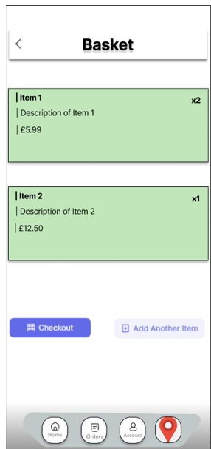
Navigation & Discoverability: Users struggled to locate the map button. Order Management & Feedback: No clear feedback on order cancellations. Basket Functionality: Users wanted a quick delete option for items.
Key Usability Issues Identified
Key usability issues: Difficulty finding the map button, unclear order cancellation feedback, and lack of a quick delete option in the cart (Nielsen, 1994).

Slide 7
Move the map button to a more prominent location.
Design Recommendations
Add a confirmation pop-up for order cancellations.
Include a quick delete button for items in the cart.
Proposed design changes: Repositioning the map button, adding a confirmation pop-up for cancellations, and implementing a quick delete option (Nielsen, 1994).

Slide 8
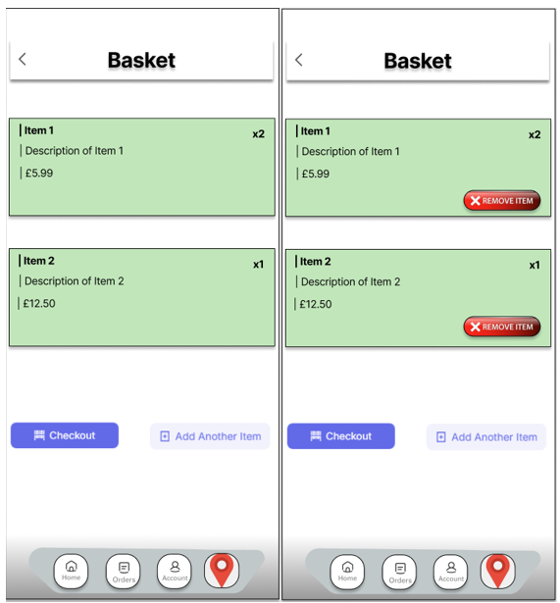
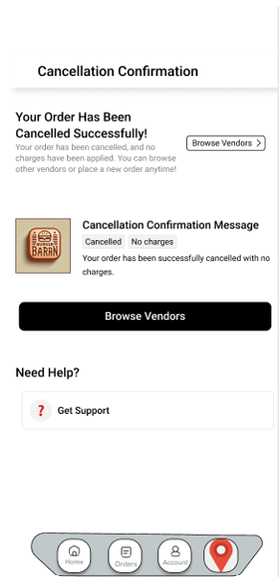
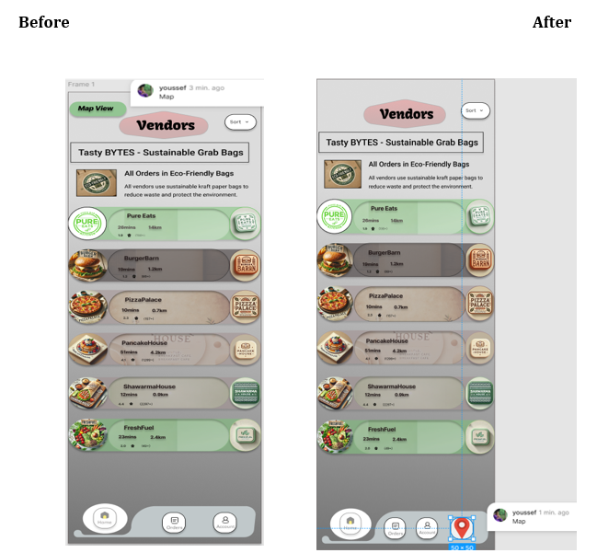
Before and after screenshots of changes.
Prototype Updates (Optional for 80+ marks)
Figma prototype reflecting recommendations.
Prototype updates in Figma demonstrate the before-and-after changes, reinforcing the importance of usability improvements (Lazar, Feng, & Hochheiser, 2017).

Slide 9
Final Takeaways: The app has strong usability but requires refinements in navigation and user feedback. Future Improvements: Conduct another round of user testing after implementing changes. Key Learnings: Importance of iterative testing in UX design.
Conclusion & Next Steps
Final recommendations: Conduct additional usability testing after implementing changes to further refine the user experience (Lazar, Feng, & Hochheiser, 2017).

Slide 10
Lazar, J., Feng, J.H., and Hochheiser, H. (2017) Research methods in human-computer interaction. 2nd edn. Cambridge: Morgan Kaufmann. Sauro, J. and Lewis, J.R. (2016) Quantifying the user experience. 2nd edn. Cambridge: Morgan Kaufmann.Nielsen, J. (1994) 10 usability heuristics for user interface design. Nielsen Norman Group. Available at: https://www.nngroup.com/articles/ten-usability-heuristics/ [Accessed March 2025]. Norman, D. (2013) The design of everyday things. Revised and expanded edn. New York: Basic Books.
Key References
Note: These are the most vital references used in my evaluation. For a full list of references, please refer to my report.

